Slide 1

Wintec
Waiata
Presented by:
Ray Smith, Timothy Howard,
Rewa Hill, Lee-Reign Ihaka,
Arielle Parai, Jin Kiat Teo

Slide 2

Contents
Prototypes
Prototypes Navigation
Video of Wintec Waiata
Navigation Diagram

Slide 3
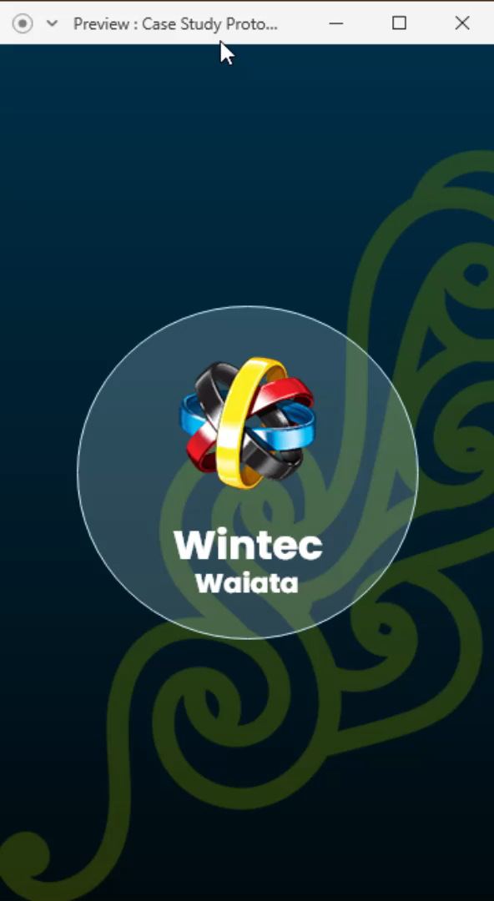

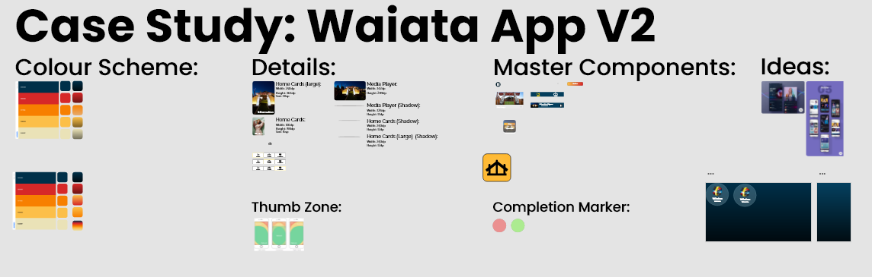

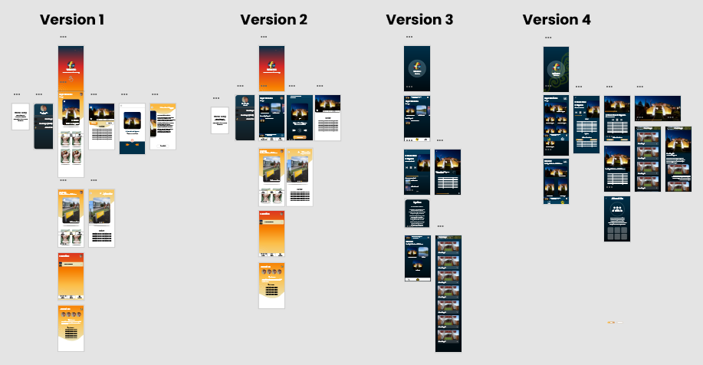

Slide 4

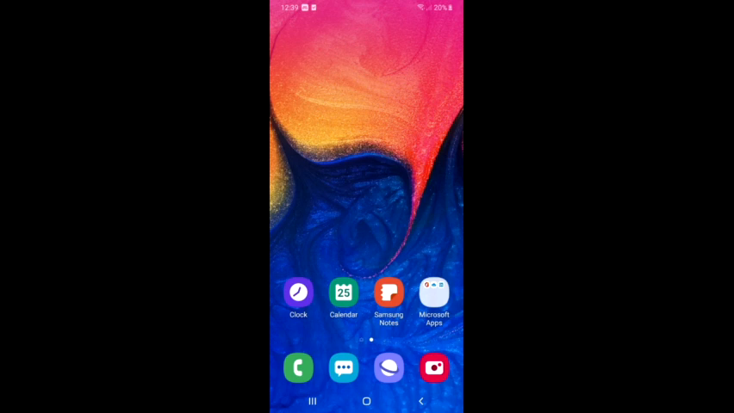

Slide 5
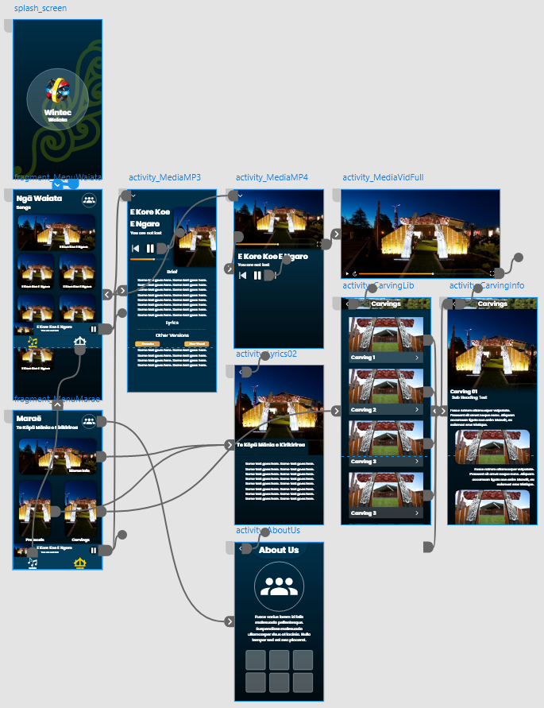


Slide 6
Thank you for tuning in!

